Slide 1
A Matrix Factorization Technique with Trust Propagation for Recommendation in Social Networks
Mohsen Jamali, Martin Ester
Simon Fraser University
Vancouver, Canada
ACM RecSys 2010

Slide 2
Outline
Introduction
Matrix Factorization Models
Basic MF Model
Social Trust Ensemble Model
The SocialMF Model
Data Sets
Experiments
Conclusions
Notes:
Here is the outline of my talk.
After some introduction, I review two matrix factorization based models. The basic matrix factorization model, and the Social Trust Ensemble model proposed for recommendation in social networks.
Then I introduce our proposed SocialMF model and its properties. I also introduce the real life data sets used in our experiments. I present the experimental results on these real life data sets and finally I will have the conclusions.

Slide 3












Introduction
Need For Recommenders
Input Data
A set of users U={u₁, …, u_{N}}
A set of items I={i₁, …, i_{M}}
The rating matrix R=[r_{u,i}]_{NxM}
Problem Definition:
Given user u and target item i
Predict the rating r_{u,i}
Collaborative Filtering Approach
Notes:
With the rapidly growing amount of information available online, it becomes necessary to have tools to help users to select the relevant part of online information. To satisfy this need, recommenders have emerged.
The input data to a recommender system is a set of users U, a set of items I, and the rating matrix R.
The problem definition is that given a user u and a target item i, predict the rating r_{u,i} of u on target item i.
Collaborative filtering approach is the most common approach for recommendation. I the CF approach, users with similar rating patterns are taken into account. The ratings of these similar users on the target item i is aggregated in CF to compute the predicted rating for user u.

Slide 4





Introduction (cont.)
Social Networks Emerged Recently
Independent source of information
Motivation of SN-based RS
Social Influence: users adopt the behavior of their friends
Social Rating Network
Social Network → Trust Network
Notes:
Online social networks have recently emerged, providing an independent source of information about users in social network. Examples of online social networks are facebook, myspace, flickr and so on.
Emergence of online social networks led to social network based recommendation. In social networks based approaches the rating s of users socially related to the target users are also considered for recommendation.
The main motivation behind social network based recommenders is social influence, meaning that users adopt the behavior of their friends. In other words the rating of a user are similar to the ratings of his neighbors in the social network.
Input here is a social rating network: a social network in which users express ratings on some items other than creating social relations with other users.
In social network based recommendation, we use the notion of trust based recommendation to emphasize on the trust aspect of social relations, and also to follow the notions used in literature. So throughout the paper and this talk, social network and trust network are used as synonyms.

Slide 5
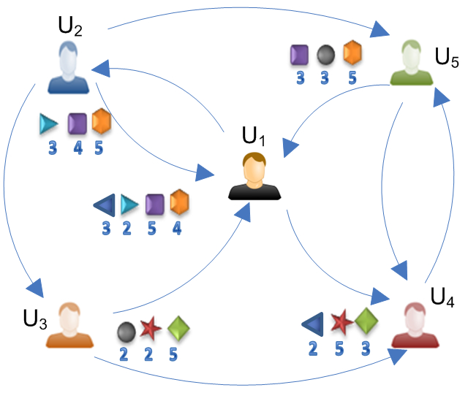
Recommendation in Social Networks
Memory based approaches for recommendation in social networks
[Golbeck, 2005]
[Massa et.al. 2007]
[Jamali et.al. 2009]
[Ziegler, 2005]
A Sample Social Rating Network
Notes:
This figure depicts a sample social rating network. As you can see, users have social relations to other users. Also they have rated some items shown by the shape icons in this figure. The numbers are the rating values. Note that in principle, these social relations or trust link could be weighted. In our experiments all data sets are binary networks with no weights. However, models introduce in this talk are able to handle the weighted networks as well as un-weighted networks.
Some memory based approaches have been proposed for social network based or trust based recommendation.
TidalTrust proposed by Golbeck in 2005 as her PhD thesis.
MoleTrust proposed by Massa et.al. in 2007.
AppleSeed proposed by Ziegler in 2005 as his PhD thesis.
And finally, TrustWalker presented by Jamali et.al. in KDD 2009.

Slide 6
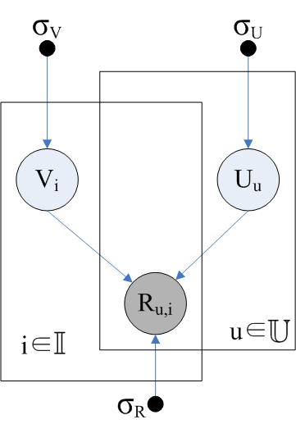


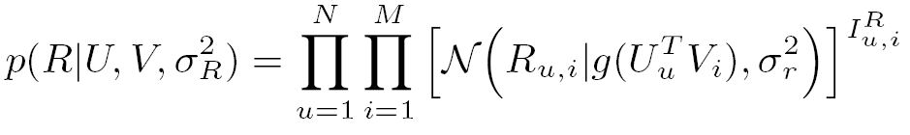
Matrix Factorization
Model based approach
Latent features for users
Latent features for items
Ratings are scaled to [0,1]
g is logistic function
U and V have normal priors
Notes:
Model based approaches also have been proposed for recommendation in social networks. Matrix factorization is one of the common techniques for model based recommendation. MF learns latent features for users and items. Each user and each item has a K dimensional latent feature vector: the latent feature of user u is denoted by U_u and stored in the u’th row of U matrix. The latent feature of item I is denoted by V_i stored in the i’th row of matrix V.
MF technique factorizes the rating matrix into product of user and item latent features. This figure shows the graphical model representing MF. The shaded circle represent the random variable for ratings expressed by users. Since the ratings are observed, they are shown as shaded circles. Two other circles denote the random variable for latent features of users and items. The small dots in this figure are the hyper parameters for the distribution of each random variable.
The conditional probability of the observed rating given latent features is as follows. Each rating r_{u,i} has normal distribution around the dot product of feature vectors of u and i with standard deviation sigma_{r}. The conditional probability of all ratings is the product of the conditional probability of every single observed rating.
It should be noted that ratings are scaled to the interval [0,1]. The function g is the logistic function to scale the dot product of latent features of users and items to the range [0,1]. Note that the latent features also have a normal prior, not shown in this equation.
Using learnt latent features, we can perform predictions by taking the dot product of a user feature and an item feature.

Slide 7
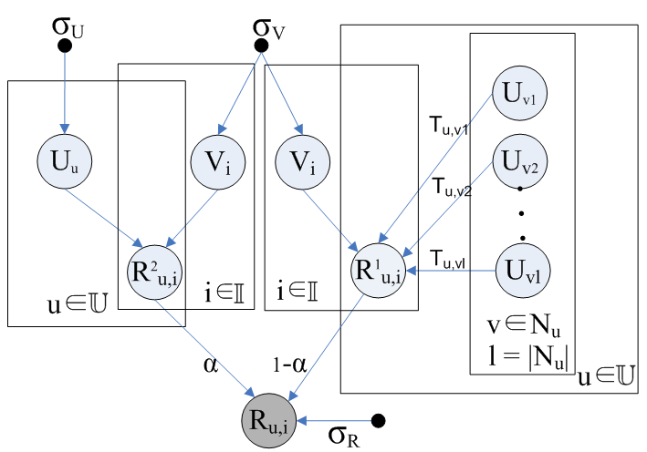
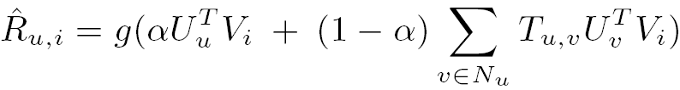
Social Trust Ensemble [2009]
Notes:
The social trust ensemble model proposed in SIGIR 2009 by MA et.al. is the closest work to our work. This model exploits MF technique for recommendation in social networks (or trust based recommendation).
STE is a linear combination of basic matrix factorization based approach and a social network based approach. This figure shows the graphical model for the STE model. The left side of this figure is a basic MF approach presented before, and the right part is the social network based part.
In the social network based part, each rating is the aggregate of the estimated ratings of neighbors on i.
In the equation U_vV_i is the estimate rating of neighbor v on i. T_u_v is the normalized trust value between u and v. In binary trust networks (such as the ones we use in our experiments) it would be one over the number of neighbors.
Alpha controls the effect of neighbors on the estimated rating.
Again, g is the logistic function scaling the result into the range [0,1]

Slide 8
Social Trust Ensemble (cont.)
Issues with STE
Feature vectors of neighbors should influence the feature vector of u not his ratings
STE does not handle trust propagation
Learning is based on observed ratings only.
Notes:
There are some issues with the STE model
Feature vectors of neighbors influence the ratings of u instead of influencing the feature vector of u.
This is not so intuitive, and also it leads to STE not handling trust propagation.
The learning of features is based on observed ratings only.
To learn the latent features of users effectively, enough rating should have been expressed by the user to be able to learn the features. Cold start users have rated only a few, so the learning is not as effective for cold start users compared to normal users.

Slide 9
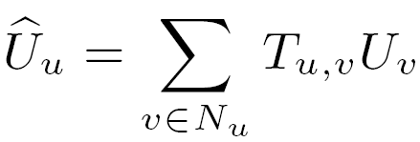
The SocialMF Model
Social Influence → behavior of a user u is affected by his direct neighbors N_{u}.
Latent characteristics of a user depend on his neighbors.
T_{u,v} is the normalized trust value.
Notes:
Now I introduce our proposed model, SocialMF. The intuition behind SocialMF is social influence. The characteristics of users are influenced by the characteristics of their friends. In other words, to put it in our framework, latent features of a user u are affected by latent features of his direct neighbors.
We consider the average of latent features of neighbors of u as an estimation of u’s latent feature.
T_{u,v} in this equation is the normalized trust value. Again, in binary trust networks (such as the ones we use in our experiments) it would be one over the number of neighbors.

Slide 10
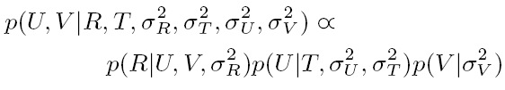
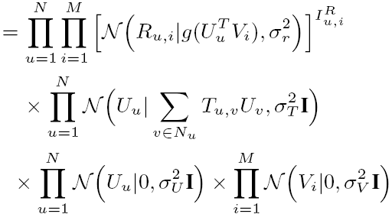
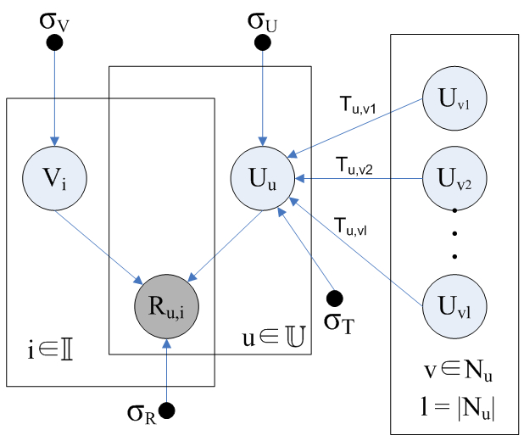
The SocialMF Model (cont.)
Notes:
Here is the graphical model representing SocialMF. As you can see, in SocialMF, direct neighbors directly influence the latent features of a user instead of influencing the rating value as in the STE model. The rating values in SocialMF depend only on the latent feature of u and i. Although, the latent features of a user depend the latent features of his neighbors.
Through a Bayesian inference, the posterior distribution of latent features is as shown in this equation: The product of probabilities of observed ratings, the normal probabilities of latent user features given the latent features of their neighbors, and the normal prior for latent features of users and items.

Slide 11
The SocialMF Model (cont.)
Notes:
Here is the graphical model representing SocialMF. As you can see, in SocialMF, direct neighbors directly influence the latent features of a user instead of influencing the rating value as in the STE model. The rating values in SocialMF depend only on the latent feature of u and i. Although, the latent features of a user depend the latent features of his neighbors.
Through a Bayesian inference, the posterior distribution of latent features is as shown in this equation: The product of probabilities of observed ratings, the normal probabilities of latent user features given the latent features of their neighbors, and the normal prior for latent features of users and items.

Slide 12
The SocialMF Model (cont.)
Notes:
Here is the graphical model representing SocialMF. As you can see, in SocialMF, direct neighbors directly influence the latent features of a user instead of influencing the rating value as in the STE model. The rating values in SocialMF depend only on the latent feature of u and i. Although, the latent features of a user depend the latent features of his neighbors.
Through a Bayesian inference, the posterior distribution of latent features is as shown in this equation: The product of probabilities of observed ratings, the normal probabilities of latent user features given the latent features of their neighbors, and the normal prior for latent features of users and items.

Slide 13
The SocialMF Model (cont.)
Notes:
Here is the graphical model representing SocialMF. As you can see, in SocialMF, direct neighbors directly influence the latent features of a user instead of influencing the rating value as in the STE model. The rating values in SocialMF depend only on the latent feature of u and i. Although, the latent features of a user depend the latent features of his neighbors.
Through a Bayesian inference, the posterior distribution of latent features is as shown in this equation: The product of probabilities of observed ratings, the normal probabilities of latent user features given the latent features of their neighbors, and the normal prior for latent features of users and items.

Slide 14








The SocialMF Model (cont.)
Notes:
In the learning phase, we use gradient descent. The gradient is computed on the log-posterior as shown here in this equation.
Lambda_u, lambda_v and lambda_t are defined as shown here to simplify our calculations.
lambda_u is set equal to lambda_v in our experiments.
Lambda_T controls the effect of latent features of neighbors on the latent features of a user. In our experiments, we perform sensitivity analysis for lambda_t to tune its value. Higher values of lambda_t means that we strongly intend to make the latent features of u close to the average of his friends.

Slide 15
The SocialMF Model (cont.)
Properties of SocialMF
Trust Propagation
User latent feature learning possible with existence of the social network
No need to fully observed rating for learning
Appropriate for cold start users
Notes:
Now I present some desirable properties of SocialMF.
Trust propagation is handled in SocialMF. Latent features of a user are dependent on latent features of his neighbors. An the latent feature of the neighbors are also dependent on the latent features of their own neighbors, propagating the dependency.
In SocialMF, even if no rating is observed for a user, the model tries to make the user’s latent features as close as possible to his neighbors. This property is appropriate for cold start users since they have only a few ratings but SocialMF learns their latent feature by making their latent features close to their friends average.
It should be noted that one of the main motivations for social network based recommendation is dealing with cold start users. So being able to model cold start users is an important feature for a recommendation model.

Slide 16

Data Sets
Epinions – public domain
Flixster
Flixster.com is a social networking service for movie rating
The crawled data set includes data from Nov 2005 – Nov 2009
Available at http://www.cs.sfu.ca/~sja25/personal/datasets/
Notes:
We performed experiments on two real life data sets: Epinions and Flixster.
The Epinions data set is a public domain data set available online. Epinions.com is an online product review service.
The other data set, the Flixster data set, we crawled from Flixster.com: a social networking service for movie ratings.
The crawled data set includes data from Nov 2005 – Nov 2009
The data set id available at this url: http://www.cs.sfu.ca/~sja25/personal/datasets/

Slide 17
Data Sets (cont.)
General Statistics of Flixster and Epinions
Flixster: 1M users, 47K items
150K users with at least one rating
Items: movies
53% cold start
Epinions: 71K users, 108K items
Items: DVD Players, Printers, Books, Cameras,…
51% cold start
Notes:
Here is the general statistics of the two data sets.
Flixster includes 1 M users, 26 M links, and 8.2 M ratings on 49K items. Only 150K users in Flixster have rated at least one item.
Epinions is a small data set with 71 K users and 104 K items. 47K users in Epinions have expressed at least one ratings.
In both data sets, more than 50% of raters are cold start users.
Flixster is a more focused data set since the items in Flixster are movies only. But items in Epinions are from several categories including DVD players, Printers, Books, Cameras, .. and so on.

Slide 18


Experimental Setups
5-fold cross validation
Using RMSE for evaluation
Comparison Partners
Basic MF
STE
CF
Model parameters
SocialMF:
STE:
Notes:
In our evaluations, we performed 5-fold cross validation, and used RMSE as evaluation metric.
Comparison partners are the basic MF model, the STE model, and CF. (Remind the description of these models)
The result for STE are for the tune value of alpha=.4. This value is tuned in the original paper using sensitivity analysis on the range [0,1], we do the same thing here.
Also lambda_u=lambda_v = .1

Slide 19
Results for Epinions
Gain over STE: 6.2%. for K=5 and 5.7% for K=10
Notes:
Results for Epinions are shown in this table. The results are presented for two different values of K, 5 and 10. Remember that K is the size of each latent feature vector. We performed experiments on several values for K and these two values are only representatives.
Results demonstrate that SocialMF outperforms other comparison partners.
Basically, the gain of SocialMF over STE is 6.2% fro K=5 and 5.7% for K=10.

Slide 20
Results for Flixster
SocialMF gain over STE (5%) is 3 times the STE gain over BasicMF (1.5%)
Notes:
The RMSE values for Flixster show similar relative results. The gain of SocialMF over STE (5%) is more than 3 times the gain of STE over BasicMF (1.5%).

Slide 21
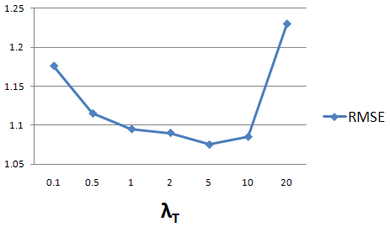
Sensitivity Analysis on λ_{T}
Sensitivity Analysis for Epinions
Notes:
We also performed sensitivity analysis on lambda_t. Remember that lambda_t controls the effect of latent features of neighbors on the latent features of a user. Very small and very large values of lambda_t lead to higher error. Lambda_t=5 is the optimum lambda_t for Epinions.

Slide 22
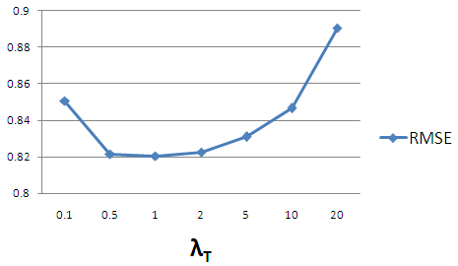
Sensitivity Analysis on λ_{T}
Sensitivity Analysis for Flixster
Notes:
For Flixster, the tuned lambda_t is 1.

Slide 23
Experiments on Cold Start Users
RMSE values on cold start users (K=5)
Notes:
Cold start users are very important in recommenders. Almost 50% of users are cold start in our data sets. This table shows RMSE values for cold start users in both data sets for K=5.

Slide 24
Experiments on Cold Start Users
RMSE values on cold start users (K=5)
Notes:
Cold start users are very important in recommenders. Almost 50% of users are cold start in our data sets. This table shows RMSE values for cold start users in both data sets for K=5.
Again, in both data sets, SocialMF outperforms comparison partners.

Slide 25
Experiments on Cold Start Users
Notes:
SocialMF outperforms comparison partners for both cold start users and normal users.
This diagram compares the gain acquired by SocialMF over STE for both cold start and all users.
As you can see in this chart, the gain for cold start users is more than the gain form normal users in both data set. This shows that SocialMF can handle cold start users much better than STE.

Slide 26


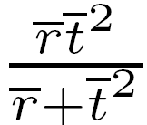
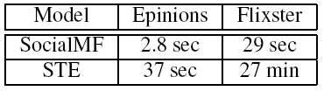
Analysis of Learning Runtime
SocialMF:
STE:
SocialMF is faster by factor
N | # of Users
K | Latent Feature Size
 | Avg. ratings per user
 | Avg. neighbors per user
Notes:
Both SocialMF and STE require time for the learning phase. The main bottleneck in the learning phase is computation of the gradient of log-posterior. The computation complexity of computing log-posterior gradient in SocialMF and in STE are given in these equations.
N is the number of users, K is the size of latent feature vectors, r-bar is the average number of ratings per user, and t-bar is the average number of links per user.
Both models are linear with respect to the number of users and size of the latent feature vectors
SocialMF is faster by the shown factor
Experiments on a Core2 Duo 2.16 GHz machine with Windows XP and 2 GB of memory
This table shows the time needed to compute the gradient of log-posterior for each model on each data set in our experiments. As shown in this table SocialMF is much faster than STE in the learning phase.
It should also be noted that the actual prediction is also faster in SocilaMF since the prediction only needs the latent features of u and I and does not depend on the latent features of neighbors as in STE.

Slide 27
Conclusion
A model based approach for recommendation in social networks based on matrix factorization
Handling Trust Propagation
Appropriate for cold start users
Fast Learning phase
Improved quality for experiments on two real life data sets.

Slide 28
Thank you!

